Slide 1

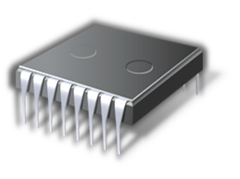


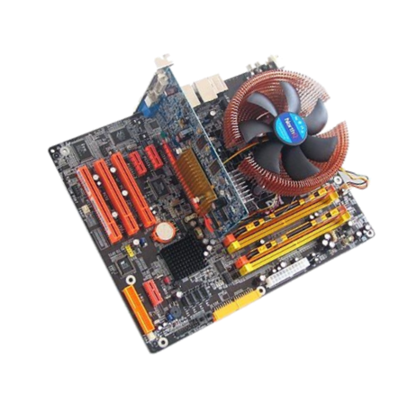

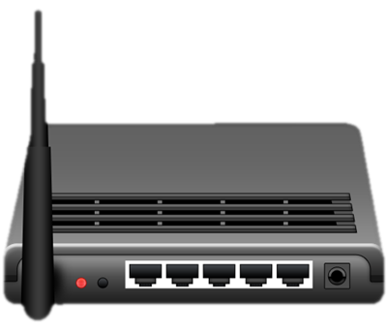
2 – Storage
Marian Marinov
CEO of 1H Ltd.
mm@1h.com
Stoyan Stoyanov
System Administrator
sto [ at ] softuni.bg

Slide 2
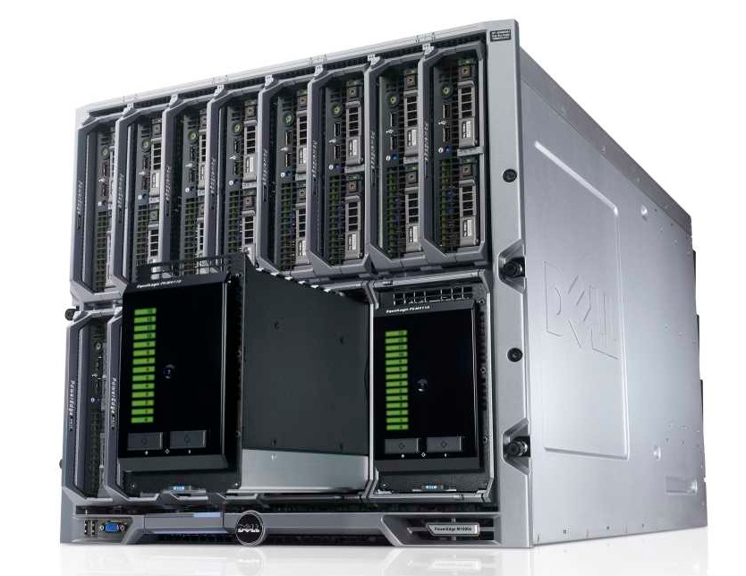
Storage
Controller
RAID
Devices
IDE/PATA
SCSI
SATA
SAS
SSD

Slide 3
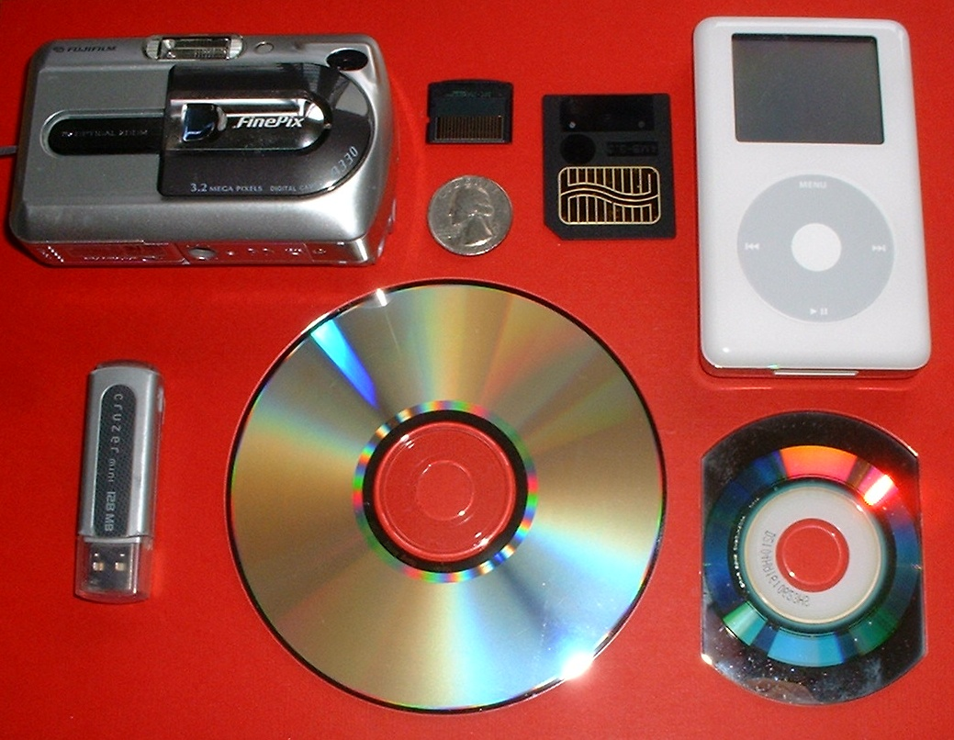
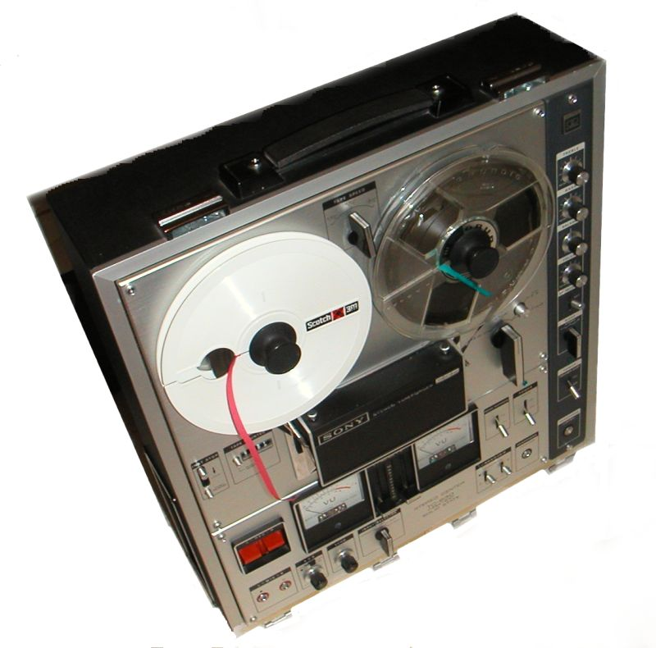
What is a Data Storage Device ?
Device that Store information, Process information or Both

Slide 4
What is Hard Disk Drive (HDD)?
Data Storage Device
    Use magnetism for storing data
    Use rapidly rotating disks (platters) with magnetic material

Slide 5
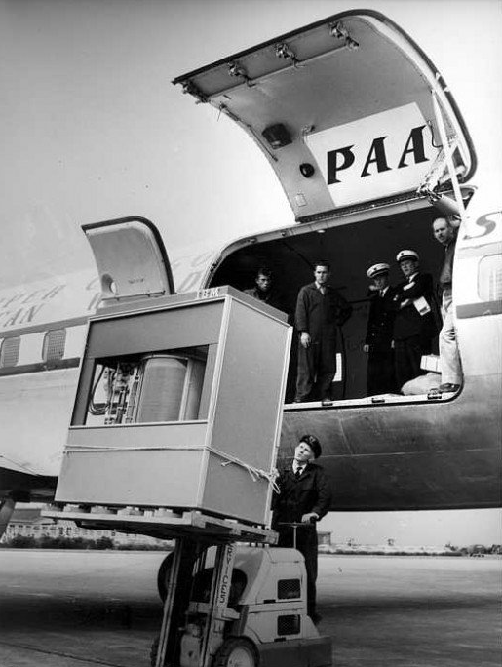
HDD in the begging...
Year: 1956
Size: 5MB

Slide 6
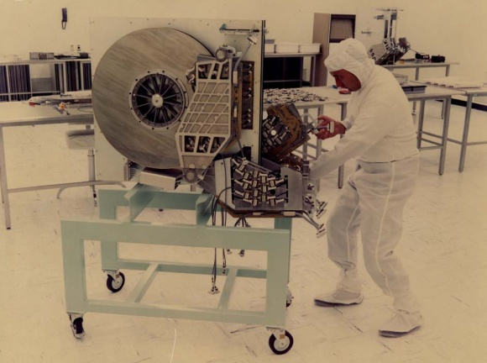
HDD in the begging...
Year: 1979
Size: 250MB

Slide 7
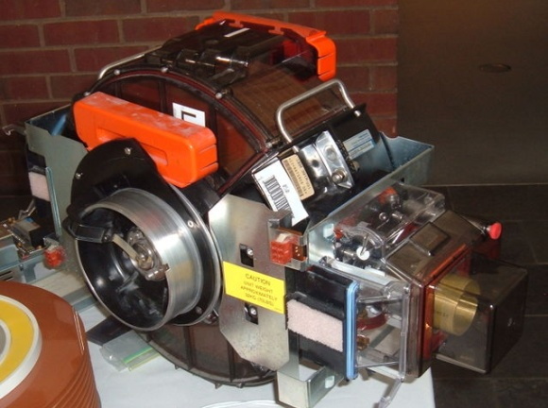
HDD in the begging...
Year: 1980
Size: 2.5GB

Slide 8
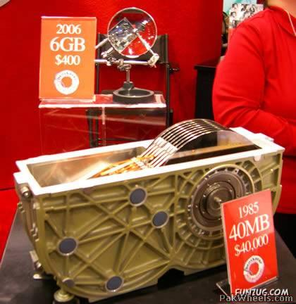
HDD: time vs technology

Slide 9
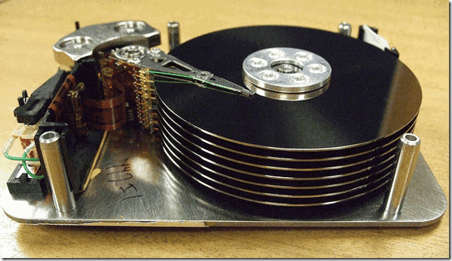
HDD

Slide 10
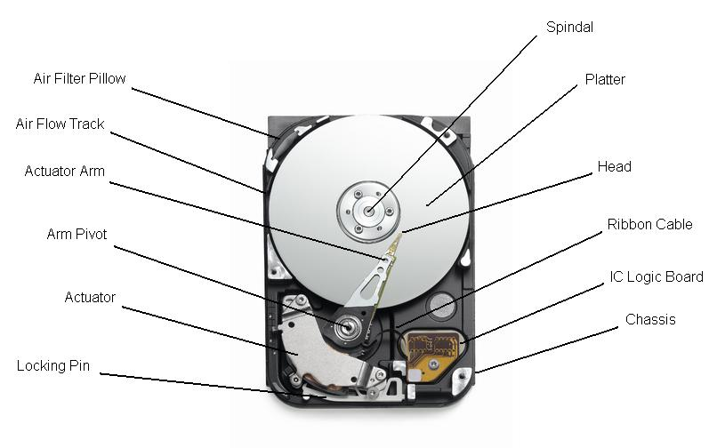
HDD Explanation:

Slide 11
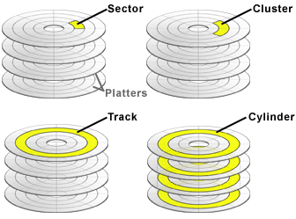
HDD Platter Explanation:
Typical sector size: 512
Newest HDDs: 4k
CDs/DVDs : 2k

Slide 12
HDD how it works? [Video]
How the hdd works in inside view

Slide 13
HDD Types
IDE a.k.a. ATA a.k.a. Parallel ATA(attachment)
SATA ( Serial ATA )
SCSI ( Small Computer System Interface )
SAS ( Serial Attached SCSI )

Slide 14
HDD Types: Parallel ATA ( PATA )
AT Attachment is an interface standard
ATA-1..ATA-6 16MB/s..133MB/s
> ATA-4 = Ultra DMA transfer modes
Primary and Secondary host controllers
Master and Slave on host controller

Slide 15
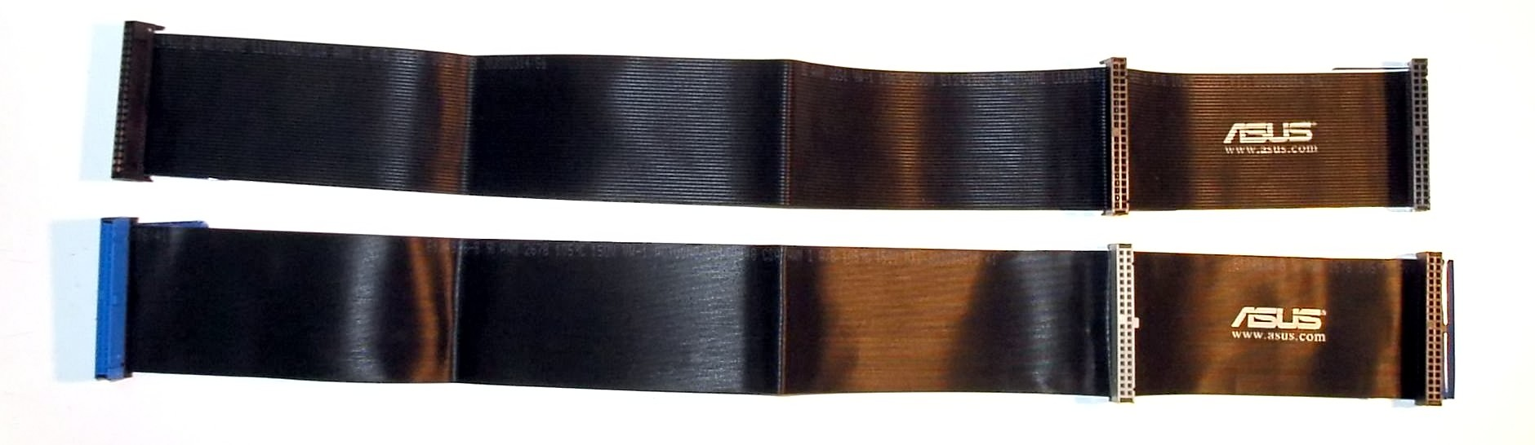
HDD Types: PATA Interface
Device0 a.k.a. Master
Device1 a.k.a. Slave
40 pins cables
After Ultra DMA/33 – 80 pins cables ( all extra pins are grounded )
Max 2 Devices per slot ( on one cable )
Maximum length 45cm

Slide 16
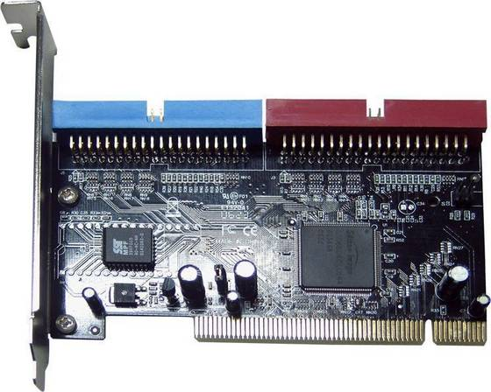
HDD Types: PATA/IDE Controller

Slide 17
HDD Types: SATA ( Serial ATA )
SATA: Serial ATA
Reduce Cable Size
Native hot-swapping
Faster data transfers
AHCI (advanced host controller interface)
  Allow hot plug
  Native Command Queuing ( NCQ )
  If AHCI not enable: SATA operates as IDE

Slide 18
HDD Types: SATA Revisions:
SATA Revision 1.0 ( SATA1 )
  1.5Gbit/s native transfer rate
  Not support NCQ
  Transfer rate of 1.2Gbit/s (150MB/s) because of 8b/10b encoding
SATA Revision 2.0 ( SATA2 )
  3Gbit/s native transfer rate
  2.4Gbit/s ( 300MB/s ) uncoded transfer rate
  Backward compatibility with SATA1
SATA Revision 3.0 ( SATA3 )
  6Gbit/s native transfer rate
  4.8Gbit/s ( 600MB/s) because of 8b/10b encoding
  Host managed NCQ
  Other: mSATA – mini-SATA 1.8” devices
            eSATA – external SATA

Slide 19
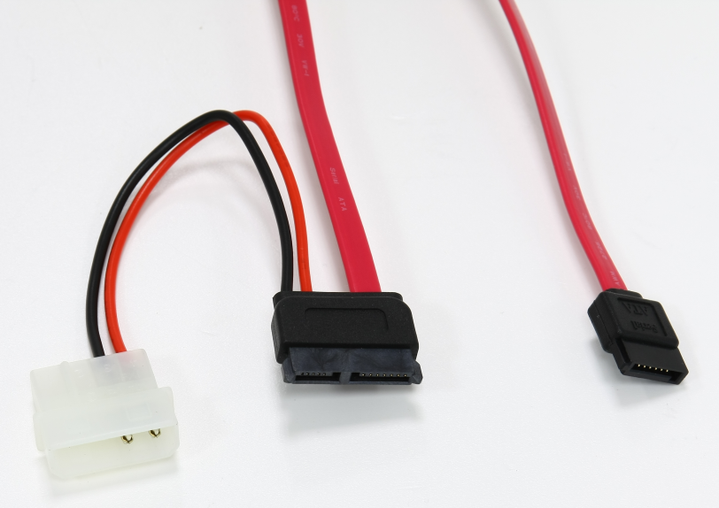
HDD Types: SATA Interface Cable:
7pins Cable:
Pins: 1,4,7 = Ground
Pins: 2,3 = Transmit
Pins: 5,6 = Receive
Cable length: 1m
eSATA Cable: 2m

Slide 20
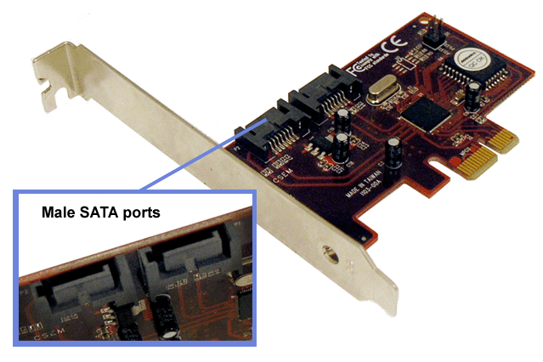
HDD Types: SATA Interface Controller

Slide 21
HDD Types: SCSI
Small Computer System Interface
Set of standards of physically connecting and transferring data
SCSI Defines: Commands, Protocols and Interfaces
Larry Boucher is considered to be the 'father' and call it sexy:)
Parallel SCSI (SPI) → first and very common
  SPI-5 standard defines transfer rate at 650MB/s
Serial SCSI (SAS) → after 2008 , replace SPI
SCSI Command Protocol (drop physical implementation):
  iSCSI → drops physical implementation, use TCP/IP as transport
  ATAPI ( ATA Packet interface ) use SCSI Commands
  USB Mass Storage class
  FireWire

Slide 22
HDD Types: SCSI
Up to 8 or 16 devices on a single bus ( single cable )
Different SCSI Standards have different maximums
SCSI-1 → 5MB/s 8devices 6meters cable length
SCSI-2 → 10MB/s 8/16devies 3m cable length
SCSI-3 → 20/40MB/s 8/16devices 3m cable length
Ultra{2,3,320} SCSI → <320MB/s 8/16devices 12m
SCSI ID (WWN) → host,drive(virtual or not), the subsystem
SCSI Initiator → mostly is the host adapter
SCSI Target → 'physical unit' is divided into smaller 'logical units'
LUN Number/ID → unique identifier for a logical unit

Slide 23
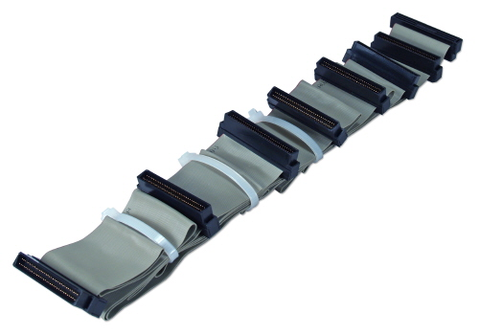
HDD Types: SCSI Interface Cable
Limited by length

Slide 24
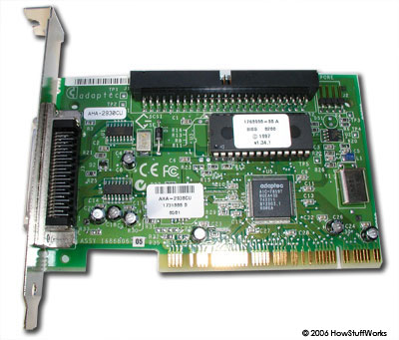
HDD Types: SCSI Interface Controller

Slide 25
HDD Types: SAS
(Serial attached SCSI)
Point-to-point serial protocol
Backward compatibility with SATA2 and later
Transport Layer:
    Serial SCSI Protocol (SSP): command level to SCSI devices
    Serial ATA Tunneled Protocol (STP): command level to SATA devices
    Serial Management Protocol (SMP): managing SAS fabric
SAS 1.1 → 300MB/s , 16256 devices(128 per expander), 6m cable length
SAS 2.1 → 600MB/s , 16256 devices(128 per expander), 6m cable length
SAS 3.0 → 1.2GB/s , 16256 devices(128 per expander), 6m cable length

Slide 26
HDD Types: SAS Interface Cables
LINK: SAS Cables

Slide 27
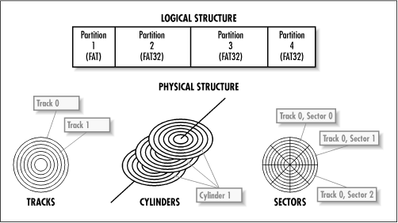
What is PARTITION?
HDD Space is divided(or partitioned) into Partitions:
Partitions cannot be overlap
HDD space that is not allocated into partition is Free Space

Slide 28
Partition Types
MBR formatted partitions: (maximum 2TB disk size)
Primary , Logical and Extended Partition types
Primary Partition – maximum 4 primary partitions on a MBR layout
Extended Partition – just a container for logical partitions (max 11)
GUID formatted partitions:
Have Only primary partitions
Support up to 128 primary partitions by default

Slide 29
Linux Partition Types
Total 97 supported partition types
The most important ones:
05 Extended
82 Linux swap / Solaris
83 Linux
85 Linux extended
88 Linux plaintext
8E Linux LVM
EE GPT
FD Linux raid autodetec

Slide 30
Device Naming scheme in Linux
hda1
| | \--- 1-x - partition numbers
| \---\
| |- a - primary master
| |- b - primary slave
| |- c - secondary master
| \- d - secondart slave
\--- hd - IDE hard disk or CDROM
sda1
| | \--- 1-x - partition numbers (1-4 primary , 5-x logical )
| \----- a-z - device name
\-------- sd - SCSI/SATA hard disk
sr1 – SCSI CDROM/DVD

Slide 31
Partitioning Commands:
DEMO:
fdisk – all-in-one, 'main' command, don't support resize
cfdisk – 'graphical' fdisk :), more user-friendly command
sfdisk – usefull for automation, in scripts, and more..
parted – MUST for GUID partition tables, more options like resize

Slide 32
Master Boot Record (MBR)
The Master Boot Record is the first sector on a hard drive. The MBR contains the bootstrap code, and possibly some other information, followed by the 64-byte partition table and a 2-byte boot signature. The 64-byte partition table has four 16-byte entries and starts at offset 446 (1BEh).
DEMO:
dd if=/dev/sda bs=510 count=1 2>/dev/null|tail -c 64 |hexdump -C
NOTE:
MBR does NOT contain any information about logical partitions
MBR gives maximum 2TB disk size because of the 512bytes

Slide 33
Extended Boot Record (EBR)
Instead, there is an Extended Boot Record (or EBR) for each logical partition. Like the MRB, the EBR is 512 bytes in length and it uses a partition table at offset 446 (1BEh) as for the MBR. Only two entries in the EBR partition table are used. The first defines the offset and size of the current partition and the second defines the offset and count to the end of the next logical partition. For the last logical partition in this singly-linked chain the second entry contains zeroes.

Slide 34
Why we need partitioning?
And what is FHS?
FHS – FileSystem Hierarchy Standard
FHS directories in /
/ → root of the tree
/Bin → Essential command binaries
/Boot → Static files of the boot loader
/Dev → Device files
/Etc → Host-specific system configuration
/Lib → Essential shared libraries and kernel modules
/Media → Mount point for removable media
/Mnt → Mount point for mounting a filesystem temporarily
/Opt → Add-on application software packages
/Sbin → Essential system binaries
/Srv → Data for services provided by this system
/Tmp → Temporary files
/Usr → Secondary hierarchy
/Var → Variable data
FHS Demo and Explanation

Slide 35
What Partition schemes to use?
Desktop: more /home? Swap?
Server:
- /boot, /tmp and the rest?
- /boot, /etc, /tmp, /usr, /var & /home at different partitions?
- /boot, /tmp, /home and the rest?
- swap?
FHS Demo and Explanation

Slide 36
What is RAID ?
RAID is:
- redundant array of independent disks
- storage 'virtualization' technology, that combine multiple disk drivers into logical unit
RAID is for:
- data redundancy
- performance
- capacity
RAID can be:
- software
- hardware

Slide 37
RAID: Standard Levels
RAID0 (Stripe)
  No Data Mirrors
  Capacity is sum of all disk in the RAID
  Data is distributed almost equal to all drives
  1 drive fail = RAID fail
RAID1 (Mirror) minimum 2 disk drives
  Data is written identically to all disks in the set
  Any read request can be served from any drive ( the fastest one )
  Any write request is written on every drive ( the slowest one )
  Operates as long as at least one drive is OK

Slide 38
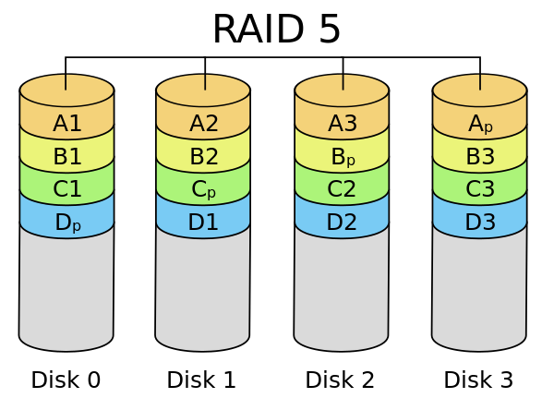
RAID: Standard Levels
RAID5 minimum 3 disk drives
    Only 1 drive can fail
Link: http://en.wikipedia.org/wiki/Parity_bit#RAID

Slide 39
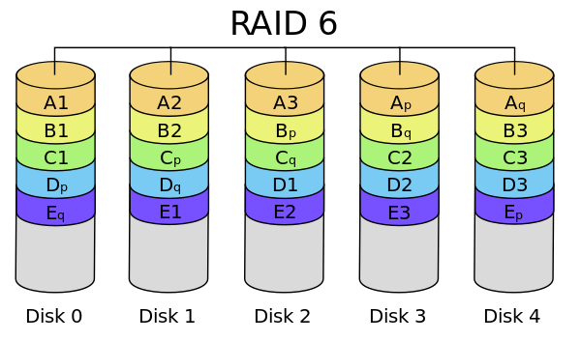
RAID: Standard Levels
RAID6 minimum 4 disk drives
    2 drives can fail
    Write performance penalty because of additional parity block
Link: http://en.wikipedia.org/wiki/Standard_RAID_levels#RAID_6

Slide 40
RAID: Nested Levels
Originally named hybrid RAID
Combine 2 or more standard RAID levels
    RAID0+RAID1 → RAID01
    RAID1+RAID0 → RAID10
    RAID10+RAID0 → RAID100
    RAID5+RAID0 → RAID50
    RAID6+RAID0 → RAID60

Slide 41
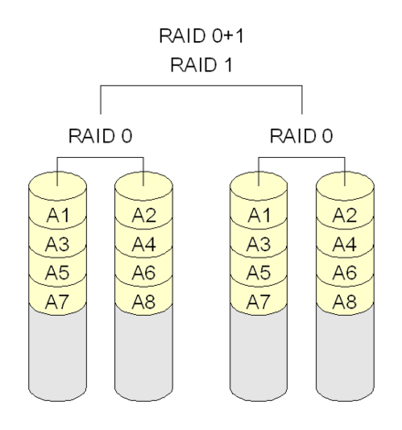
RAID: Nested Levels
RAID01

Slide 42
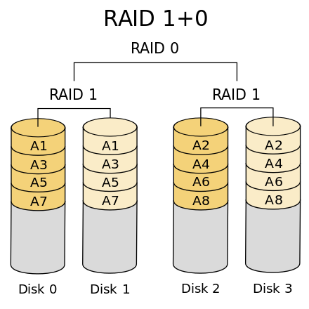
RAID: Nested Levels
RAID10
It is the preferable RAID level for I/O-intensive applications such as database, email, and web servers, as well as for any other use requiring high disk performance.

Slide 43
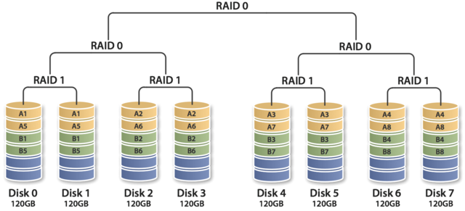
RAID: Nested Levels
RAID100
* generally implemented using software RAID 0 over hardware RAID 10

Slide 44
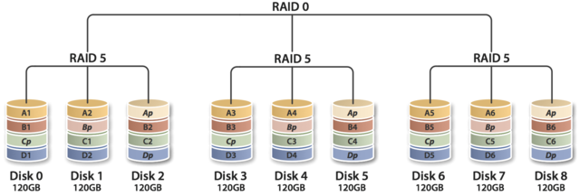
RAID: Nested Levels
RAID50

Slide 45
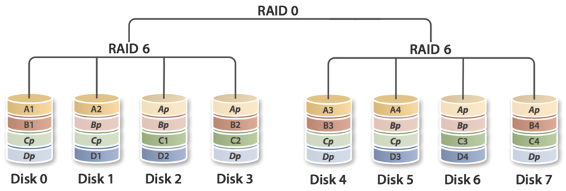
RAID: Nested Levels
RAID60

Slide 46
Linux Software RAID Commands
Creating RAID1:
mdadm --create /dev/md0 --level=1 -n2 /dev/sda1 /dev/sdb2
Add array to mdadm config file: (/etc/mdadm.conf || /etc/mdadm/mdadm.conf)
mdadm –detail –scan >> /etc/mdadm.conf
Remove Disk from array:
mdadm –fail /dev/md0 /dev/sda1 # First mark it as failed
mdadm –remove /dev/md0 /dev/sda1 # remove it from the array
Add Disk to Existing Array:
mdadm –add /dev/md0 /dev/sda1
Verifying Raid Status:
cat /proc/mdstat || mdadm –detail /dev/md0
Deleting Raid array:
mdadm –stop /dev/md0
mdadm –remove /dev/md0

